Slide 1
Zomato Restaurants Analysis
A Comprehensive Overview of Restaurant Data Insights
Submitted By: Anuj Srivastava
(23MCI10056)
Subject: Data Analytics (23CAH - 725)

Slide 2
Introduction
The Zomato Restaurants Analysis project provides a detailed analysis of restaurant data sourced from Zomato, a prominent platform for discovering and reviewing restaurants. This report outlines objectives, methodologies, findings, and implications for stakeholders in the restaurant industry.

Slide 3
Table of contents
About Zomato
Project Overview
Project Objectives
Data Sources
Methodology
Analysis and Findings - Excel
Analysis and Findings - Power BI
Implications of Findings

Slide 4
About Zomato
Zomato is an online platform offering information about restaurants. It provides details such as location, ratings, reviews, menus, and photos. It operates in multiple countries and has a comprehensive restaurant database.

Slide 5
Project Overview
The project undertakes an in-depth analysis of Zomato restaurant data. Utilizes tools and techniques including Excel, SQL, Power BI, and Tableau. Aims to gain insights into trends related to location, opening trends, ratings, and price ranges.

Slide 6
Project Objectives
Develop a comprehensive Country Map Table. Construct a Calendar Table using Datekey. Determine the Number of Restaurants based on City and Country. Analyze restaurant openings based on Year, Quarter, and Month. Compute Average Ratings and categorize by Average Price. Examine restaurants with table booking and online delivery options. Create charts based on Cuisines, City, and Ratings.

Slide 7
Data Sources
Primary data sourced from Zomato's extensive restaurant database. Additional data may include public datasets and supplementary collections.

Slide 8
Methodology
Data extraction and cleaning using Excel and SQL. Analysis employing advanced Excel functions and SQL queries. Visualization with Power BI and Tableau for creating interactive dashboards.

Slide 9
Analysis and Findings - Excel
Utilized advanced Excel functions for data manipulation and visualization. Created charts and graphs for data analysis on locations, ratings, and cuisines. Conducted statistical analysis to identify trends and patterns.

Slide 10
Analysis and Findings - Power BI
Developed interactive dashboards in Power BI for data exploration. Visualized trends related to restaurant locations, ratings, and cuisines. Implemented interactive tools for deeper data analysis.

Slide 11
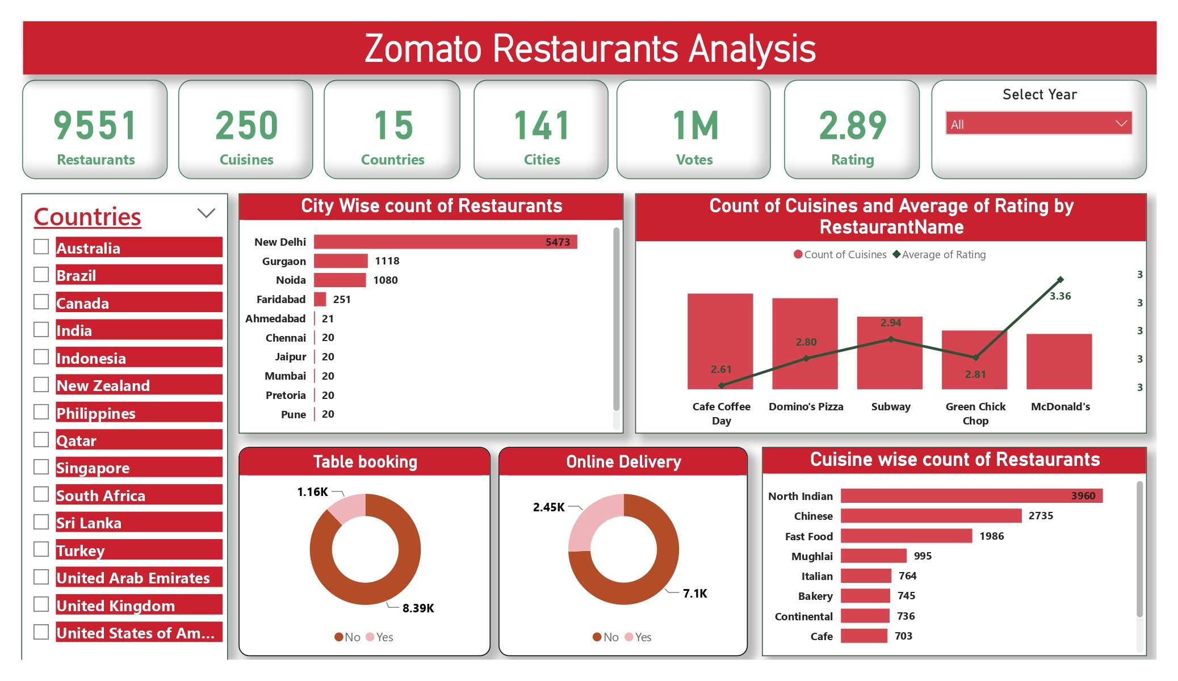

Slide 12
Implications of Findings
Identified popular restaurant locations and trending cuisines. Gained insights into seasonal variations and opening trends. Provided analysis on customer preferences to inform strategic decisions.

Slide 13
Conclusion
The Zomato Restaurants Analysis project reveals critical insights into the restaurant industry landscape. The use of advanced analytics enhances understanding of market trends and customer preferences. This comprehensive analysis facilitates data-driven decision-making for stakeholders in the restaurant sector.

Slide 14
Thank you!
Do you have any questions?

